Slide 1

Mission Possible Emerging Leaders Academy
Team 1 – Project Proposal
Abby Gettinger, Alexis Jones, Marva Lee, Michelle Hite, Nicole Harris, Sara Parsons, Randall Allen

Slide 2
DHS Career Development Portal
A centralized, user-friendly, talent management interface
Notes:
It is our proposal that the Department of Human Services needs to provide “a centralized, user-friendly, talent management interface, i.e. a Career Development Portal.” This Career Development Portal would provide a means by which DHS employees can engage directly in their career growth and development and where Talent Management can provide assistance and guidance as needed.

Slide 3





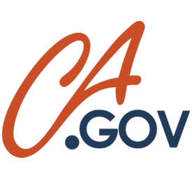




Who’s Using Career Development Portals?

Slide 4
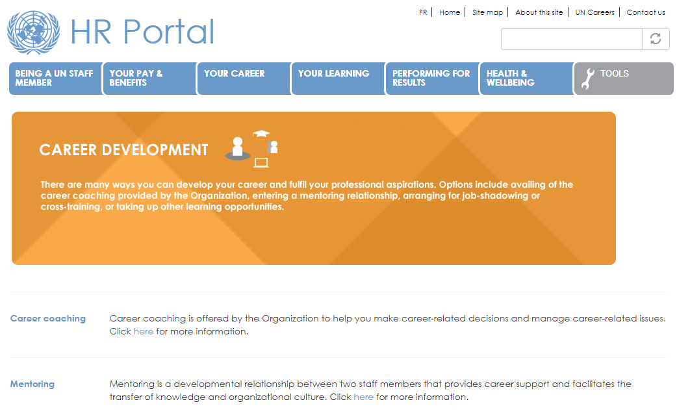

Slide 5


DHS Career Development Portal
Professional Profile
Explore
Personal Career Plan
Learn
Training & Academies
Online Training Record
Grow
Job Readiness Help
Job Notifications

Slide 6
Professional Profile
The profile page
is the portion of the career development portal
that can be most personalized!

Slide 7
69%

Slide 8


Slide 9


User Friendly
Customizable
Secure

Slide 10

Make Connections

Slide 11

Maintain Control

Slide 12

Show Off and Share Your Accomplishments

Slide 13

Online Portfolio with the Basics
Resume
Career Summary
Goals
Skills
Accomplishments
Letters of Recommendations
Transcripts
Degrees
Certifications
Military Records
Volunteering

Slide 14
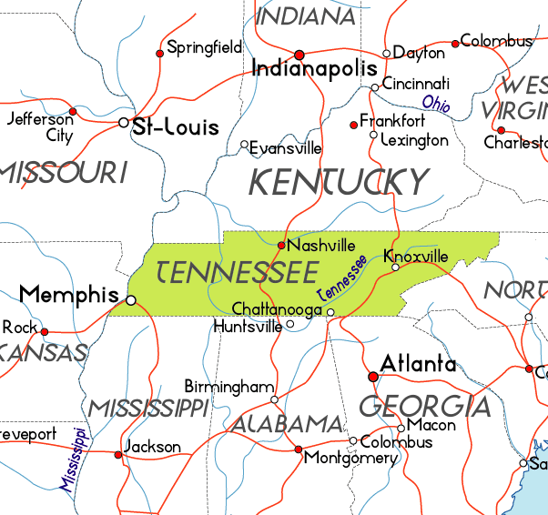

Slide 15
DHS Career Development Portal
Professional Profile
Explore
Personal Career Plan
Learn
Training & Academies
Online Training Record
Grow
Job Readiness Help
Job Notifications

Slide 16

Navigating the Workforce
Personal Career Development

Slide 17
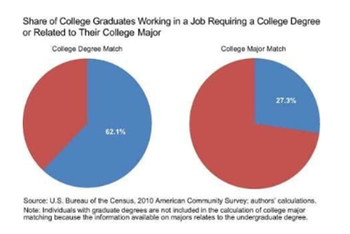
Only 27% of college grads have a job related to their major
Notes:
Here is some interesting new data from Jaison Abel and Richard Dietz of the Federal Reserve Bank of New York. The vast majority of U.S. college grads, they find, work in jobs that aren’t strictly related to their degrees:

Slide 18

What jobs are available that I might like?

Slide 19
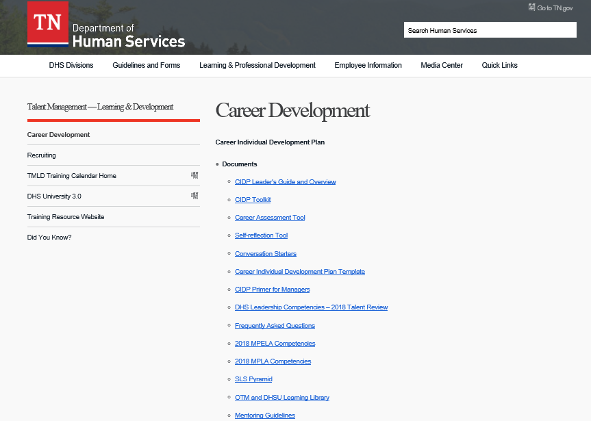
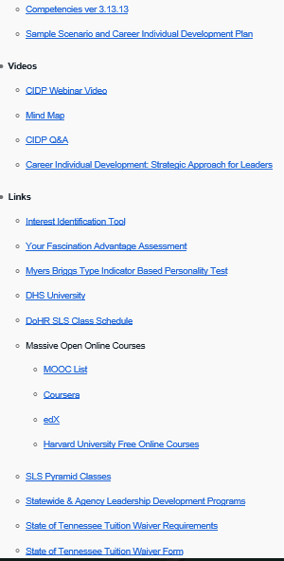
What Tools Are Available Now?

Slide 20
Tab Basics
Personal Career Plan Notes
(Only seen by the Employee)
Posted Goals Showing Interests and Intentions
(Can be seen by others on the Profile)

Slide 21
Career Plan Notes
Upload Test Results (Ex: “Next Move” Test)
Guided Path to Inspire the Employee (Ex: Self Reflection Tool)
List Possible Schools or Trainings of Interest (Ex: MPELA, Conferences, Mentors to Pursue)

Slide 22

Goals & Interests
Post Learning “In Progress”
Post Fields of Interest
List Skill Sets/Strengths
Express Availability to Move/Continue Education

Slide 23

Our Mission
To build strong families by connecting Tennesseans to employment, education and support services.

Slide 24
DHS Career Development Portal
Professional Profile
Explore
Personal Career Plan
Learn
Training & Academies
Online Training Record
Grow
Job Readiness Help
Job Notifications

Slide 25

Trainings & Academies
To create one cohesive page for ease of access to all learning opportunities

Slide 26

Internal Training Opportunities (Mission Possible Academies, Lunch ‘n Learns, Application Trainings, etc.)
Mandatory Trainings (Edison)
External Learning Opportunities (Workshops, Seminars, etc. )

Slide 27

Bridge and Pathways Program
Using your strengths and interests as a method to build a bridge and follow a pathway to the next step in your career

Slide 28
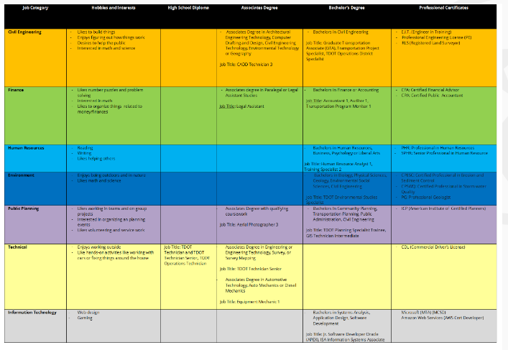
Career Pathways at TDOT

Slide 29

Department Walk-Throughs
A summary of positions and agencies within DHS
Skills and experience that is useful or mandatory for these careers

Slide 30

Job Shadowing
An opportunity to determine if you are a good fit for the position
Allows for the prospect of internal hiring and promotions

Slide 31
DHS Career Development Portal
Professional Profile
Explore
Personal Career Plan
Learn
Training & Academies
Online Training Record
Grow
Job Readiness Help
Job Notifications

Slide 32
Online Training Record
A TOOL
TO HELP YOU
SELL YOURSELF!

Slide 33

Why is it important?
To highlight knowledge, skills, competencies and abilities of an employee.
Keywords of a skill set can be matched to certain career opportunities.

Slide 34
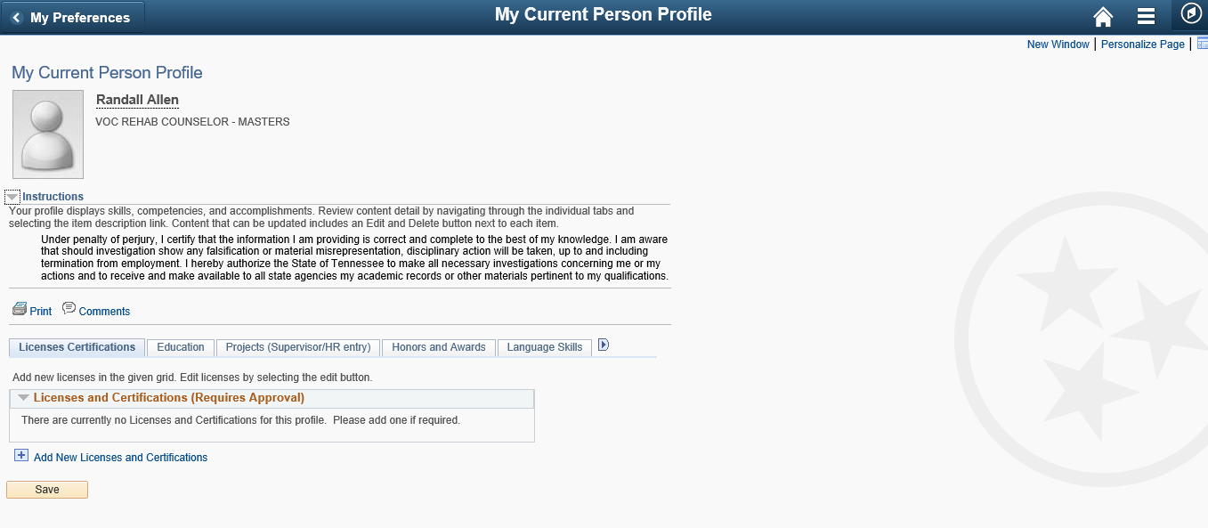
Name
Position

Slide 35
DHS Career Development Portal
Professional Profile
Explore
Personal Career Plan
Learn
Training & Academies
Online Training Record
Grow
Job Readiness Help
Job Notifications

Slide 36
Job Readiness Assistance
A user-friendly, one-stop-shop of information, tools, and assistance
to help ready interested DHS employees for advancement and growth in their careers.

Slide 37
Why Job Readiness?
Will empower active interest in one’s career and future within DHS.
Will provide the opportunity to experience the benefits of MPELA program.
Will increase morale through increased career support.
Will decrease employee turnover and job dissatisfaction.
Will develop leaders and prepare employees who better serve our clients.

Slide 38

Job Readiness Services
Cover Letters
Resumes
Interviewing tips/best practices
Job shadowing
Cross trainings opportunities

Slide 39
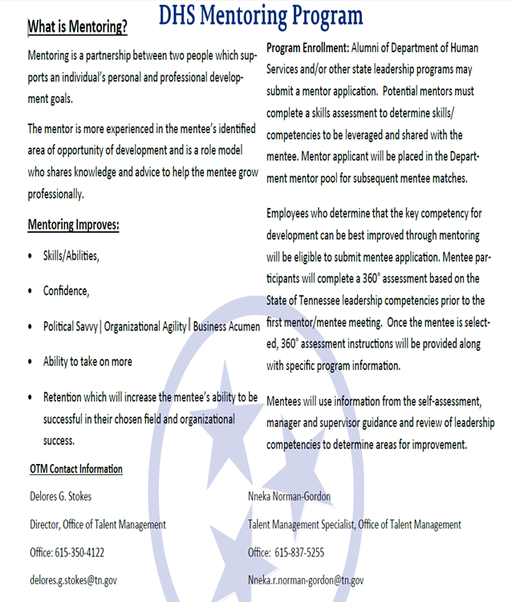
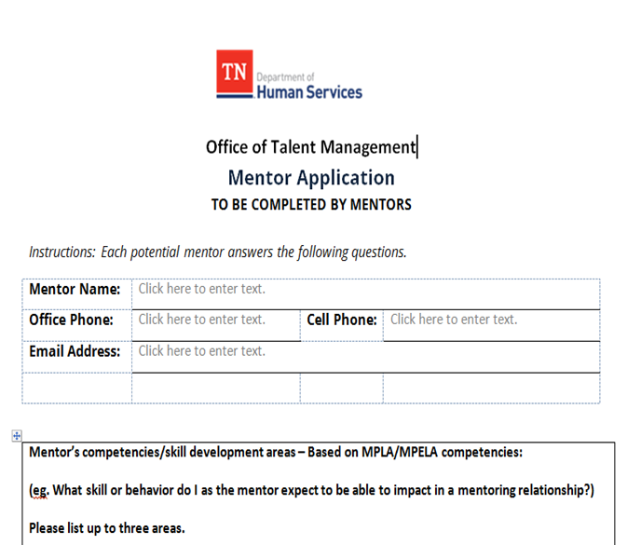
TMLD Is On Our Side

Slide 40
DHS Career Development Portal
Professional Profile
Explore
Personal Career Plan
Learn
Training & Academies
Online Training Record
Grow
Job Readiness Help
Job Notifications

Slide 41
Job Notifications
How will the system determine what jobs to send you?
When will you get those notifications?
How will you receive notifications?

Slide 42


Q: How will the system determine what
jobs to send you?
A: Jobs that are the perfect match for
you!

Slide 43


How do we achieve this?
Employees
Hiring Managers
Notes:
1:Employees setting up Profile with their strengths, training history and overall things that make them shine
Hiring Managers spending time posting jobs and also narrowing down the competencies and skills that are the most important for this position.
Competencies for the same job might differ depending on what part of the state you are in
Mutually benefical for employees and hiring managers

Slide 44

Q: When will you get notifications?
A: When utilizing the Career Development
Portal you will get Job Notifications early.
Notes:
A benefit of this portal is that, if you take the time to fight for yourself(making your profile, keeping it up to date) we will reward that by giving you a heads up on job postings before they are shared with other state employees or general public. You will have the opportunity to talk with hiring managers via the portal, apply for the position and hear more about what specific skills they are looking for.

Slide 45

Q: How will you receive notifications?
A: You will be able to select to receive
your notifications by text, email
and/or system notices.
Notes:
Share example: We desire for people to want to be on the portal, checking their notifications, updating their profile regularly and looking for opportunities. Similar to how people are addicted to social media and checking in regularly. The next generation of workers desire this type of portal.

Slide 46

Retain employees by putting the tools in their hands for them to succeed and develop outside their current departments.
Hiring managers can search and find people they might NEED on their teams.

Slide 47
Final Considerations
Allow for better focus on employee development.
Enable more informed decisions on transfers and promotions.
Increase communication and engagement of employees.
Promote greater job satisfaction and employee longevity.

Slide 48


Final Considerations (Cont.)
Meet the expectations of today’s technology savvy workforce.
Help promote the company brand.
Is doable!

Slide 49
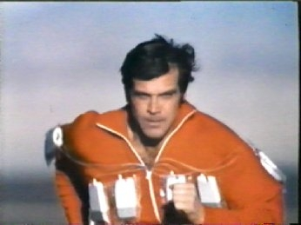
We can build it!
We have the technology!

Slide 50
Sources
"A Career Development Portal." Addept Solutions, 2011, www.addept.com/downloads/pdf/ACareerDevelopmentPortal.pdf. Accessed May 2019.
"Career Pathways at TDOT." Tennessee State Government - TN.gov, www.tn.gov/tdot/human-resources-home/tdot-careers/career-pathways-at-tdot.html. Accessed June 2019.
"Career Portals & Toolkits Overview." MasteryWorks Career Development Solutions, www.masteryworks.com/newsite/toolkits-portals/toolkits_overview.htm. Accessed May 2019.
"DHS Mission, Vision and Core Values." Tennessee State Government - TN.gov, www.tn.gov/humanservices/dhs-mission.html. Accessed June 2019.

Slide 51
Karl, Tom, and Caela Ferren. "A Foundation for Career Conversations: Career Development Portals." MasteryWorks Home Page, 2009, www.masteryworks.com/newsite/clientimpact/impact_archives_may09.htm. Accessed May 2019.
Mcilvaine, Andrew R. "Facebook Unveils New Career-Development Portal." HRExecutive.com, 14 Nov. 2018, hrexecutive.com/facebook-unveils-new-career-development-portal/. Accessed 6 June 2019.
"Online Training Record." Edison, State of Tennessee, sso.edison.tn.gov/psp/paprd/EMPLOYEE/EMPL/s/WEBLIB_PTAL.ISCRIPT1.FieldFormula.IScript_PTAL_DASHBOARD?tab=ESS_WORKCENTER. Accessed June 2019.

Slide 52
Plummer, Brad. "Only 27 percent of college grads have a job related to their major." The Washington Post, WP Company, 20 May 2013, www.washingtonpost.com/news/wonk/wp/2013/05/20/only-27-percent-of-college-grads-have-a-job-related-to-their-major/?utm_term=.365031e72915&noredirect=on. Accessed June 2019.
Wellins, Richard S., et al. "Nine Best Practices of Effective Talent Management." DDI | Leadership Development & Assessment | DDI, 2009, www.ddiworld.com/resources/library/white-papers-monographs/nine-best-practices-of-effective-talent-management. Accessed May 2019.
Younas, Muhammad. "Seven Reasons Why A Career Portal Solution Needs To Be Your Top Priority." Entrepreneur, 27 June 2017, www.entrepreneur.com/article/297319. Accessed 3 June 2019.

Slide 53
Departmental Contacts
Delores G. Stokes – Director, Office of Talent Management, Learning
and Development
Devin Stone – Director of Communications, Public Information and
Legislative Office
Kevin V. Wesley – Assistant Director, Office of Talent Management,
Learning and Development
Kimberly Mantlo – HR Program Director 4, Department of Human
Resources
N’Neka Norman-Gordon – Talent Management Specialist, Office of
Talent Management, Learning and Development
Sherron Brown – Director of Operations, ACCENT and TCSES
Solutions Delivery, Division of Family Assistance and Child
Support

