Slide 1

HIV Positive Clients
A Training Module for
Vocational rehabilitation counselors and service providers
Randall Allen
Psychosocial/Multicultural Aspects of Disability
University of Tennessee, Knoxville
Summer 2014

Slide 2
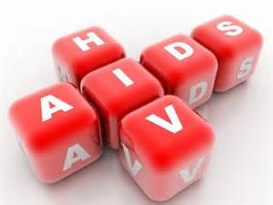
The Purpose of this Training
To educate vocational rehabilitation counselors and service providers on key issues related to working with clients who are HIV positive to avoid discriminatory practices, whether intentional or unintentional, that undermine the self-determination and person-centered goals of our customers.

Slide 3
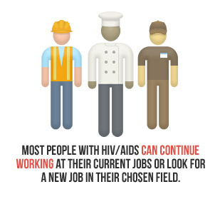
The HIV Positive Client

Slide 4
HIV Positive Clients Increasing
RSA data, between 2002 and 2007, indicates the total number of consumers with HIV/AIDS exiting VR services increased by 67%.
While in the same period of time the overall number of VR consumers exiting VR services decreased.

Slide 5

Primary Reason for Increase
Newer and more advanced medical treatments are extending life spans and allowing persons with HIV/AIDS to remain healthy longer and able to work.

Slide 6
Advances in Medical Treatment
Anti-Retroviral Therapy
Targeted Treatments
Anti-retroviral treatments like HAART (highly active anti-retroviral treatment) interrupt the RNA to DNA conversion of the virus.
New inhibitors can target specific stages in the life cycle of the virus as well as specialized treatments that target infections and tumors associated with the virus.

Slide 7
The Results
As a result of these advances in treatment of HIV:
“Between 1994 and 1997, AIDS deaths decreased by 75% and the occurrence of AIDS-defining diseases decreased by 73%.” (Howard, 2009)

Slide 8
An Employment Statistic
But while these advances may in part explain why consumers with HIV/AIDS are seeking VR services in increasing numbers, actual successful employment outcomes for consumers with HIV remains lower than that of VR consumers in general. (Jung & Bellini, 2011)

Slide 9
Group Discussion
What are some barriers to employment for consumers with HIV/AIDS?
Notes:
Use this time to allow participants to brainstorm regarding potential barriers to employment for HIV Positive clients. What they should take away from this discussion is that there are a multitude of possible barriers as in most cases of someone with a disability. This should not be a surprise.

Slide 10
Digging Deeper
How many of these potential barriers are based on misinformation or misperceptions about Persons with HIV/AIDS?
Notes:
Building on the previous question and information, ask participants to identify barriers that arise due to misinformation and misperceptions. Point out that these are often the source of discriminatory practices that arise in an employment situation or in the provision of services.

Slide 11
Misinformation and Misperceptions Produce
Fear
Discrimination
Prejudice

Slide 12

Getting It Right in VR
If right information and right perception can aid in preventing discriminatory practices in the provision of vocational rehabilitation services, then professionally it is important that we get our information and outlook right.

Slide 13
Removing the Barriers
Barriers to Good Service
Assets to Good Service
Fear
Discrimination
Prejudice
Accurate Medical Information
Correct Understanding of ADA Law
Personal commitment to professional and ethical behavior

Slide 14
What Are You Afraid Of?
The Fear of Infection

Slide 15

10 Most Common Fears About HIV Transmission
Swimming in a Pool
Coughing or Sneezing
Chewing Gum
Mosquito Bites
Public Bathrooms
Eating at a Restaurant
Getting a Lap Dance
Sharing a Drink Glass
Shaking/Holding Hands
Kissing
From TheBody.com – Click here to view online

Slide 16

The Real Story About HIV Transmission
Human Immunodeficiency Virus (HIV) is a BLOOD BORNE pathogen which requires blood-to-blood contact to be transmitted.
It CANNOT be contracted through the air or through casual contact.
It is transmitted through SEXUAL CONTACT and BLOOD CONTACT.

Slide 17
Transmission of HIV AIDS
Sexual Contact
Blood Contact (4 ways)
Most common mode of transmission
Passed through white blood cells containing HIV
Passed through bodily fluids, such as semen and vaginal secretions
Blood product transfusions
Intravenous drug use
Maternal-fetal transmission
Occupational exposure in a healthcare setting

Slide 18
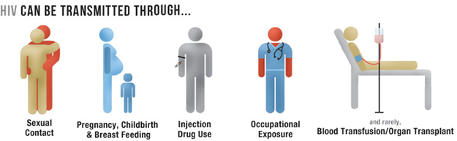
A Visual Review

Slide 19

Best Practices
The development of an Exposure Control Plan required by OSHA
Annual instruction in Blood Borne Pathogen safety for VR staff
(United States Department of Labor, 2012)
Notes:
The Department of Labor Occupational Safety and Health Administration requires that if that if there is “the presence or the reasonably anticipated presence of blood or other potentially infectious materials on an item or surface” then an Exposure Control Plan is to be in place. (United States Department of Labor, 2012)

Slide 20
What Are You Doing?
American with Disabilities Act (ADA) and the HIV Consumer

Slide 21

Does the ADA apply to Vocational Rehabilitation and Community Resource Providers?
“The ADA applies to all State and local governments, their departments and agencies, and any other instrumentalities or special purpose districts of State or local governments.”
(U.S. Department of Justice, 2012)

Slide 22

A Right To Equal Access
No qualified individual with a disability shall, on the basis of disability, be excluded from participation in or be denied the benefits of the services, programs, or activities of a public entity, or be subjected to discrimination by any public entity. [ADA §35.130(a)]

Slide 23
Scenario 1
Is this permissible?
A consumer with HIV is referred to a community resource provider for supported employment. The referral is declined on the basis that the job placement counselor is uncomfortable working with the consumer.

Slide 24

We cannot deny access to a qualified person with a disability.
“A public entity, in providing any aid, benefit, or service, may not, directly or through contractual, licensing, or other arrangements, on the basis of disability— Deny a qualified individual with a disability the opportunity to participate in or benefit from the aid, benefit, or service.”
ADA §35.130(b)(1)(i)

Slide 25
Scenario 2
Is this permissible?
A client with HIV would benefit from job development and job placement services. When discussing the service with the client, the counselor does not inform the client that this service is available through her office by the Business Employment Specialist. Instead, the counselor opts to tell her client of an outside agency in the adjacent town to which the counselor would like to refer her.

Slide 26

Not only is it not permissible, what about informed choice?
“A public entity may not deny a qualified individual with a disability the opportunity to participate in services, programs, or activities that are not separate or different, despite the existence of permissibly separate or different programs or activities.”
ADA §35.130(b)(2)

Slide 27
Scenario 3
Is this permissible?
A consumer with HIV is referred for work adjustment services at a community TRC. The referral is declined on the basis that due to the nature of the work, there is real and potential danger of contamination of other workers.

Slide 28
Maybe Yes; Maybe No
“A public entity may impose legitimate safety requirements necessary for the safe operation of its services, programs, or activities. However, the public entity must ensure that its safety requirements are based on actual risks, not on mere speculation, stereotypes, or generalizations about individuals with disabilities.” [ADA §35.130 (h)]

Slide 29
“Direct Threat?”
It is a question of safety
Must pose a significant risk of substantial harm
Cannot be reduced by providing “reasonable accommodation”
Must be established through objectively medically supportable methods
Cannot be determined based on an assumption
Transmission of HIV will rarely be a legitimate “direct threat” issue (U.S. Department of Justice, 2012)

Slide 30

IN SUMMARY
In our capacity as vocational rehabilitation professionals, we must insure that the decisions we make and the actions we take, personally and as an agency, must be in accordance with the American with Disabilities Act (ADA) in order to protect the rights of persons with HIV, to allow them full access to services, and to aid them in achieving their employment goals.
The Essence of Discrimination
http://youtu.be/LBP8QDlm6OA

Slide 31
What are you thinking?
Prejudice
leads to
discrimination

Slide 32
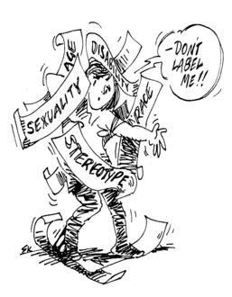
What is Prejudice
A preconceived judgment or opinion
An adverse opinion or leaning formed without just grounds or before sufficient knowledge
An instance of such judgment or opinion
An irrational attitude of hostility directed against an individual, a group, a race, or their supposed characteristics
(Merriam-Webster, 2014)

Slide 33

Who Gets Infected with HIV?
The quality of our service to persons with HIV should not be affected by the following:
Sexual Orientation
Race/Ethnicity
Gender Identity
Political Leanings
Lifestyle Choices
This is not the issue in regards to how we should provide services to or feel and think about the persons we are serving.

Slide 34

People From All Walks of Life Can Have HIV
Notes:
Statistically, it is true that gay and bisexual men are most likely to contract HIV/AIDS, that African-Americans carry the most severe burden of HIV, and that the average age range of people contracting HIV 13-24. Statistically, 1.1 million people in the U.S have HIV/AIDS. (U.S. Department of Justice, 2012, June 6)

Slide 35

The Value of Valuing Others
Even if you feel that your opinions or judgments on certain matters as it relates to a person’s life have merit whether they are based on your particular religion, moral code, or reasoned position, we must always seek to value others. It is called UNCONDITIONAL POSITIVE REGARD or UPR.

Slide 36
What is Unconditional Positive Regard?
It is an approach that sees all human beings as having an innate urge toward socially constructive behavior (e.g. the desire to work).
It is an approach that sees all people as having a need for self-determination and that self-determination needs to be respected.
It is an approach that sees the more that a person’s self-determination is respected the more their urge for socially constructive behavior will take hold.
(Joseph, 2012)

Slide 37
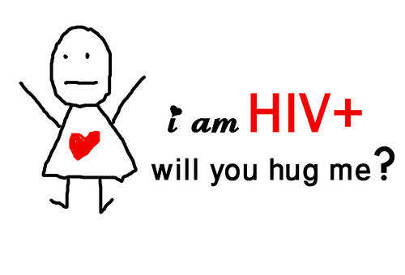
Unconditional Positive Regard respects the person with HIV as a human being
“Unconditional positive regard therefore means valuing the person as doing their best to move forward in their lives constructively and respecting the person’s right to self-determination no matter what they choose to do.
That doesn’t mean that you need to like the person or approve of what they do. Nor does it mean that you have to simply put up with what they do if you see it as dangerous in some way.”
(Joseph, 2012)

Slide 38
Summary: Our Personal Responsibility
What we cannot do
What we must do
Deny a person with HIV access to services
Treat them as less than ourselves
Discriminate in how we provide services
Show disrespect for their life choices and/or life circumstances
Avoid false assumptions which lead to prejudicial thoughts and behaviors
Suspend moral, religious, and reasoned differences for the good of the person
Value the person with HIV as a person

Slide 39
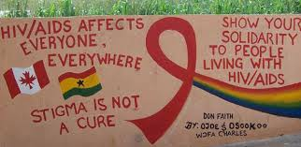
Conclusion of Training
Acquiring accurate medical knowledge,
Understanding our legal obligations as defined in the Americans with Disabilities Act of 1990 (ADA)
Advocating for Unconditional Positive Regard in our one-on-one work with persons with HIV.
We have addressed in this training the importance of combating fear, discrimination, and prejudice regarding working with clients with HIV by …

Slide 40

Any Questions?

Slide 41
Sources
Americans With Disabilities Act of 1990, Pub. L. No. 101-336, 104 Stat. 328 (1990).
Bellini, Y. J. (2011). Predictors of Employment Outcomes for Vocational Rehabilitation Consumers with HIV/AIDS: 2002-2007. Rehabilitation Counseling Bulletin , 142-153.
Falvo, D. R. (2014). Medical and Psychosocial Aspects of Chronic Illness and Disability. Burlington: Jones & Bartlett Learning.
Joseph, S. (2012, October 7). Unconditional Positive Regard. Retrieved July 30, 2014, from Psychology Today: http://www.psychologytoday.com/blog/what-doesnt-kill-us/201210/unconditional-positive-regard
Martin G. Brodwin, F. W. (2009). Medical, Psychosocial and Vocational Aspects of Disability. Athens: Elliott & Fitzpatrick, Inc.
Mello, J. A. (1999). Ethics in Employment Law: The Americans with Disabilities Act and the Employee with HIV. Journal of Business Ethics , 67-83.
“prejudice.” Merriam-Webster.com. 2014. http://www.merriam-webster.com/dictionary/prejudice (6 August 2014)
U.S. Department of Justice. (2012, June 6). HIV in the United States: At a Glance. Retrieved August 6, 2014, from ADA.gov: http://aids.gov/hiv-aids-basics/hiv-aids-101/statistics/
U.S. Department of Justice. (2012, June). Questions and Answers: The Americans with Disabilities Act and Persons with HIV/AIDS. Retrieved August 2, 2014, from ADA.gov: http://www.ada.gov/aids/ada_q&a_aids.pdf
10 Fears About HIV Transmission. (2011, July 27). The Body: The Complete HIV/AIDS Resource. Retrieved August 5, 2014, from http://www.thebody.com/content/63213/ten-common-fears-about-hiv-transmission.html
United States Department of Labor. (2012, April 3). Occupational Safety and Health Administration. Retrieved August 5, 2014, from United States Department of Labor: https://www.osha.gov/pls/oshaweb/owadisp.show_document?p_table=STANDARDS&p_id=10051
Tennessee Division of Rehabilitation Services. (2009). Vocational Rehabilitation Services Policy Manual. Nashville: Tennessee Department of Human Services.

